Slide 1



BookWhisperer
A Recommendation System web application
with NLP Summarization & Text-To-Speech

Slide 2
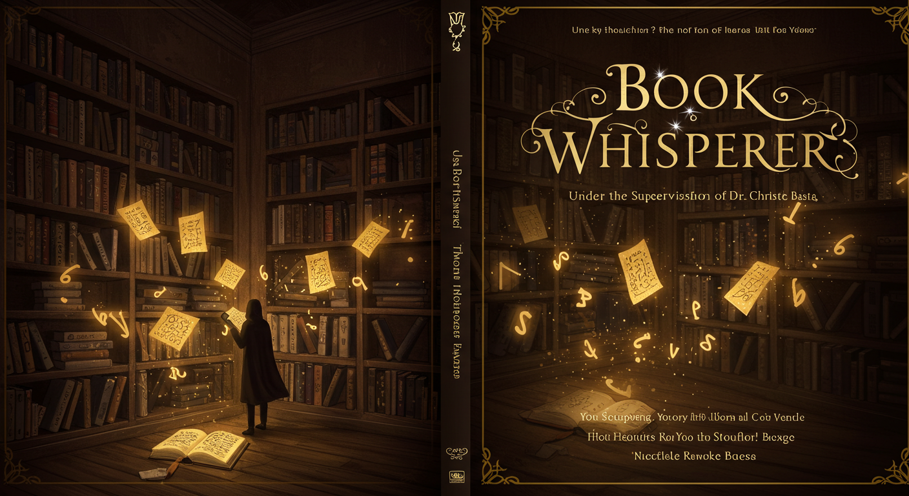
BookWhisperer
A Recommendation System web application
with NLP Summarization & Text-To-Speech

Slide 3
BookWhisperer
A Recommendation System web application
with NLP Summarization & Text-To-Speech

Slide 4


Bavly Maged Sedky

Slide 5

Bishoy Ayad Fahmy Habib

Slide 6
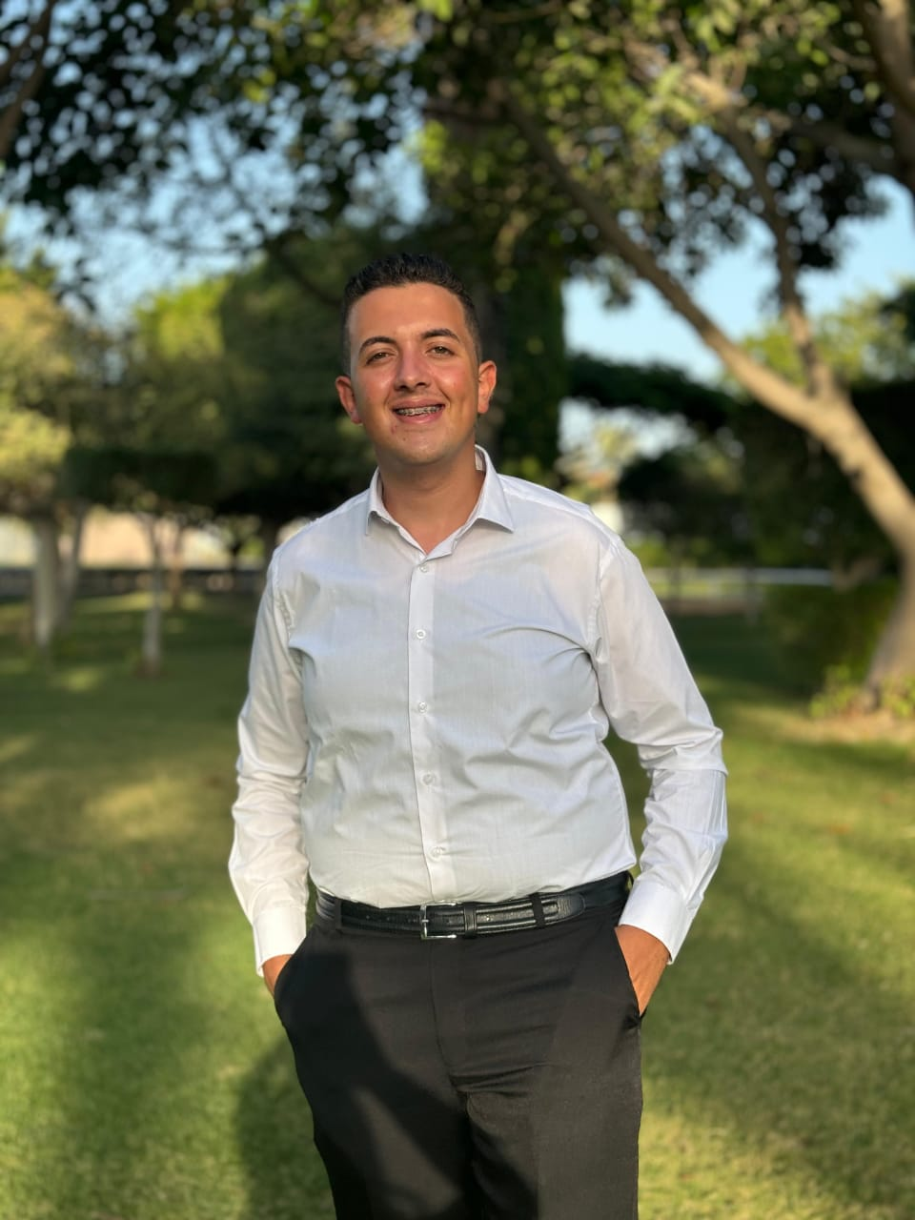
George Mamdouh Gamil

Slide 7

Mohommed Alaa Mohammed

Slide 8

Mohamed Gamaleldin Elsayed

Slide 9
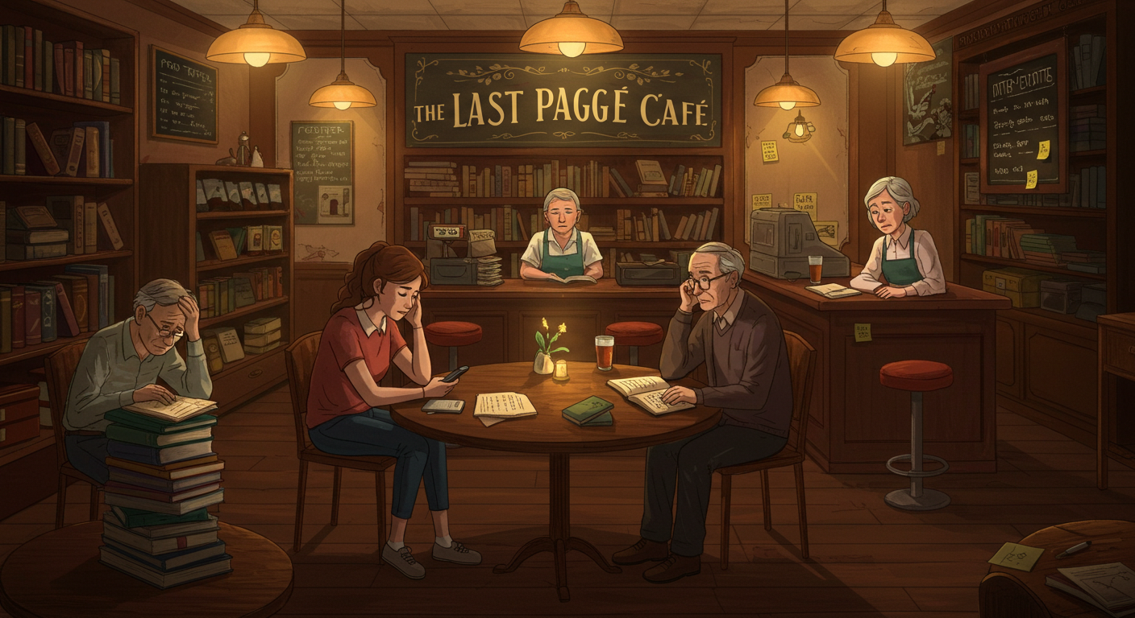

Youssef Aly Elsayed

Slide 10
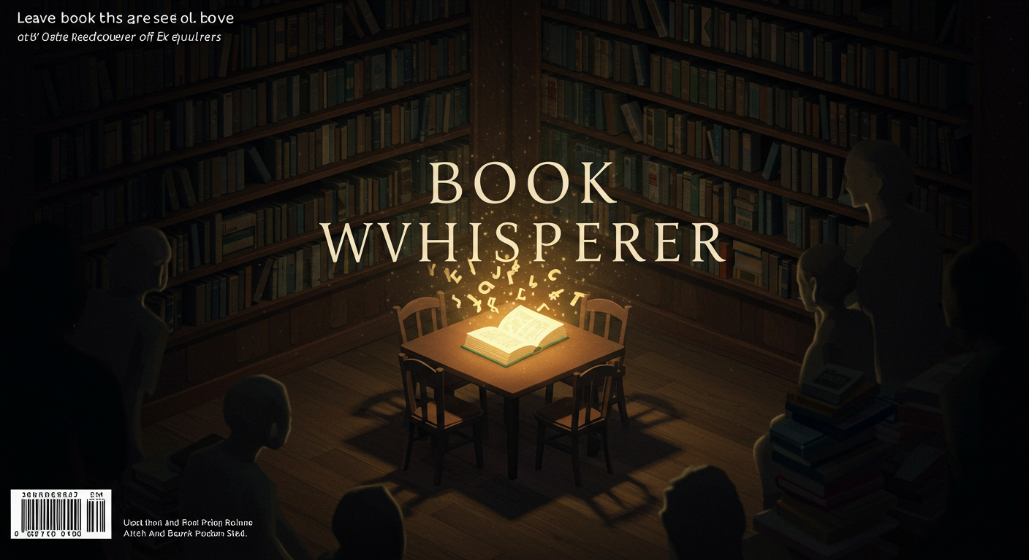

Slide 11
The Problem: A World Full of
Books, But Out of Reach

Slide 12
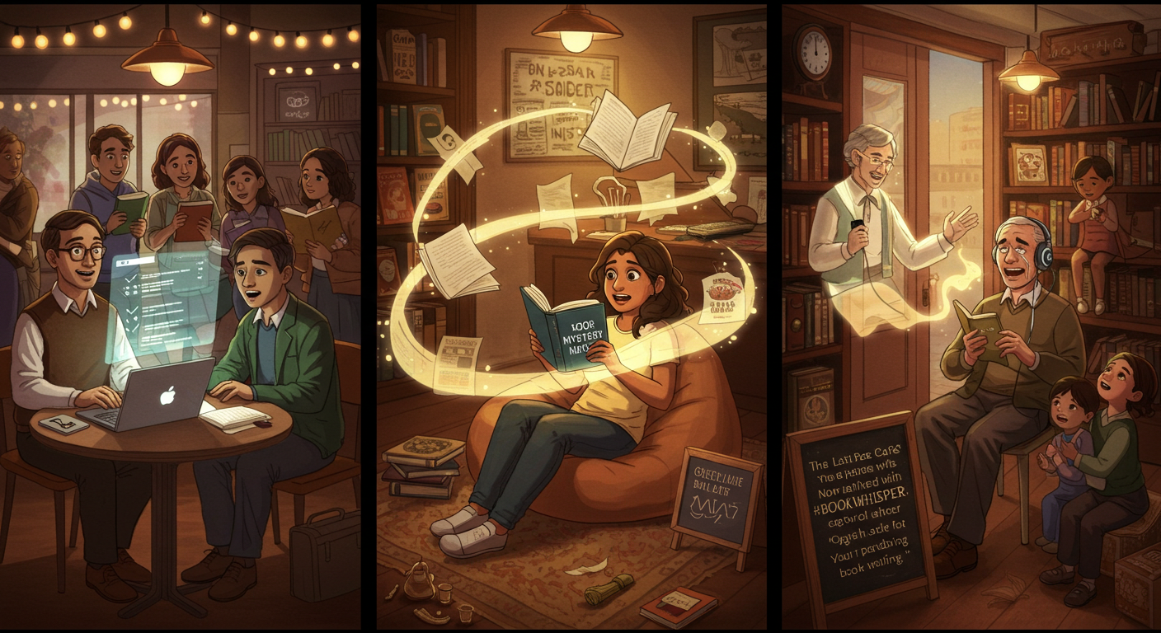
"The Last Page Café: Where No Reader is Left Behind"
The Problem: A World Full of Books, But Out of Reach
Professor Michael rubbed his temples, staring at a towering stack of student
theses. "I can’t keep up—there’s too much to read, and too little time to
understand it all.“
Seva, finally read a book she truly loved—engaging, fast-paced, and full of
twists. Now, all she wanted was to find more books with the same kind of
content, but endless scrolling left her overwhelmed and unsure where to look.
Mr. Romany , the bookstore’s oldest customer, ran his fingers over a paperback
he could no longer see. “A lifetime of stories, and now I can’t even read the
blurry titles,” he said sadly. With shelves full of old classics, his fading eyesight
made it impossible to enjoy the books he loved most.

Slide 13
The Solution: A Book That
Meets You Where You Are

Slide 14

"The Last Page Café: Where No Reader is Left Behind"
So we decided to design our web app
The Solution: A Book That Meets You Where You Are
Professor Michael uploaded a dense academic paper.
Instant Summary → The AI highlighted key arguments in bullet points.
Seva took the "Book Recommender Tool "
Tailored Recommendations → The algorithm understood her.It learned her
short attention span.And her love for twisty mysteries.It suggested books
with the same energy and suspense.
Mr. Romany found an old classic he thought he’d never experience again.
One-Click Audiobook → With a simple photo, the book came back to
life.OCR extracted the text from the pages.With one click, it turned into an
audiobook.The voice didn’t sound robotic.It was warm and natural—like a
friend reading aloud.

Slide 15

So we decided to design our web app
Speechify:
Text to Speech ✅
Add Files ✅
Read Pictures ✅
Recommendation System ❌

Slide 16

So we decided to design our web app
Similar web Applications
Speechify:
Text to Speech ✅
Add Files ✅
Read Pictures ✅
Recommendation System ❌
Amazon Polly:
Text to Speech ✅
Add Files ❌
Read Pictures ❌
Recommendation System ❌
So we decided to design our web app

Slide 17

Similar web Applications
Amazon Polly:
Text to Speech ✅
Add Files ❌
Read Pictures ❌
Recommendation System ❌
Google text to speech:
Text to Speech ✅
Add Files ❌
Read Pictures ❌
Recommendation System ❌
Speechify:
Text to Speech ✅
Add Files ✅
Read Pictures ✅
Recommendation System ❌

Slide 18

Similar web Applications
Google text to speech:
Text to Speech ✅
Add Files ❌
Read Pictures ❌
Recommendation System ❌
Amazon Polly:
Text to Speech ✅
Add Files ❌
Read Pictures ❌
Recommendation System ❌

Slide 19
Similar web Applications
BookWhisperer :
Text to Speech ✅
Add Files ✅
Read Pictures ✅
Recommendation System ✅

Slide 20

Our web Applications
BookWhisperer :
Text to Speech ✅
Add Files ✅
Read Pictures ✅
Recommendation System ✅

Slide 21
Our web Applications
Business Understanding

Slide 22
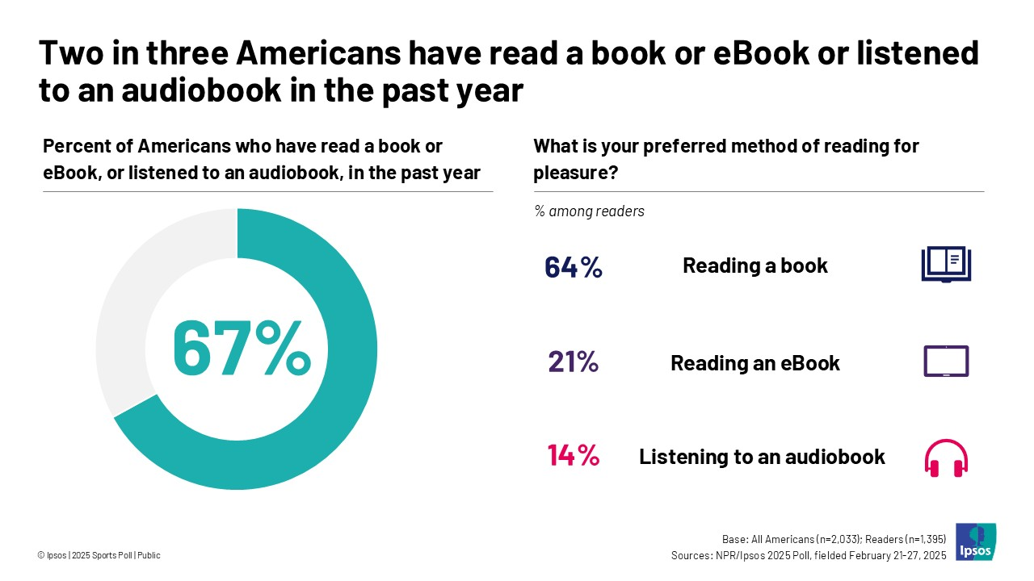
Business Understanding
Business Understanding
Poll on preference to reading a book vs listening to audio books
Ipsos poll 7 April 2025

Slide 23
Business Understanding
Value
of Recommendations
Business Understanding
Poll on preference to reading a book vs listening to audio books
Ipsos poll 7 April 2025

Slide 24

Value
of Recommendations
Netflix
2/3 rated movies are from recommendation

Slide 25
Value of Recommendations
Value
of Recommendations
Netflix
2/3 rated movies are from recommendation
Amazon
35% sales are from recommendation

Slide 26

Value of Recommendations
Netflix
2/3 rated movies are from recommendation
Amazon
35% sales are from recommendation
Google News
38% more click-through are due to recommendation

Slide 27
Value of Recommendations
Netflix
2/3 rated movies are from recommendation
Amazon
35% sales are from recommendation
Google News
38% more click-through are due to recommendation

Slide 28
Value of Recommendations
Source of Data
Netflix
2/3 rated movies are from recommendation
Amazon
35% sales are from recommendation
Google News
38% more click-through are due to recommendation

Slide 29
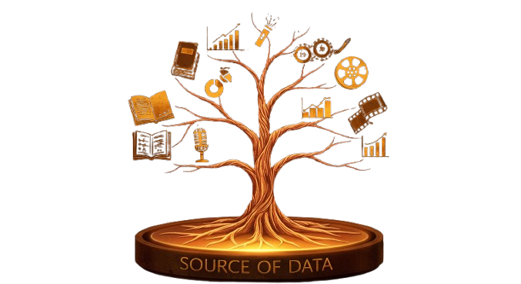
Source Of Data

Slide 30

Source of Data
BookCrossing Dataset from Kaggle
Source Of Data
ISBN Challenges
Multiple ISBNs for same title
Some invalid/duplicate ISBN entries
Community-based book sharing platform where users:
Register books by ISBN
Release books "into the wild" for others to find
Track book journeys globally
Contains 278,858 users who contributed 1,149,780
ratings for 271,379 books

Slide 31
DATA QUALITY ISSUES
BookCrossing Dataset from Kaggle
ISBN Challenges
Multiple ISBNs for same title
Some invalid/duplicate ISBN entries
2.Data Inconsistent
Inconsistent formatting
Spelling variations
Missing geographic hierarchy

Slide 32
DATA QUALITY ISSUES
BookCrossing Dataset from Kaggle
ISBN Challenges
Multiple ISBNs for same title
Some invalid/duplicate ISBN entries
2.Data Inconsistent
Inconsistent formatting
Spelling variations
Missing geographic hierarchy
3.Publication Year
Future dates for classic works
Zero/placeholder values where year is unknown
Inconsistent handling of reprint years vs original publication

Slide 33
DATA QUALITY ISSUES
BookCrossing Dataset from Kaggle
ISBN Challenges
Multiple ISBNs for same title
Some invalid/duplicate ISBN entries
2.Data Inconsistent
Inconsistent formatting
Spelling variations
Missing geographic hierarchy
3.Publication Year
Future dates for classic works
Zero/placeholder values where year is unknown
Inconsistent handling of reprint years vs original publication

Slide 34

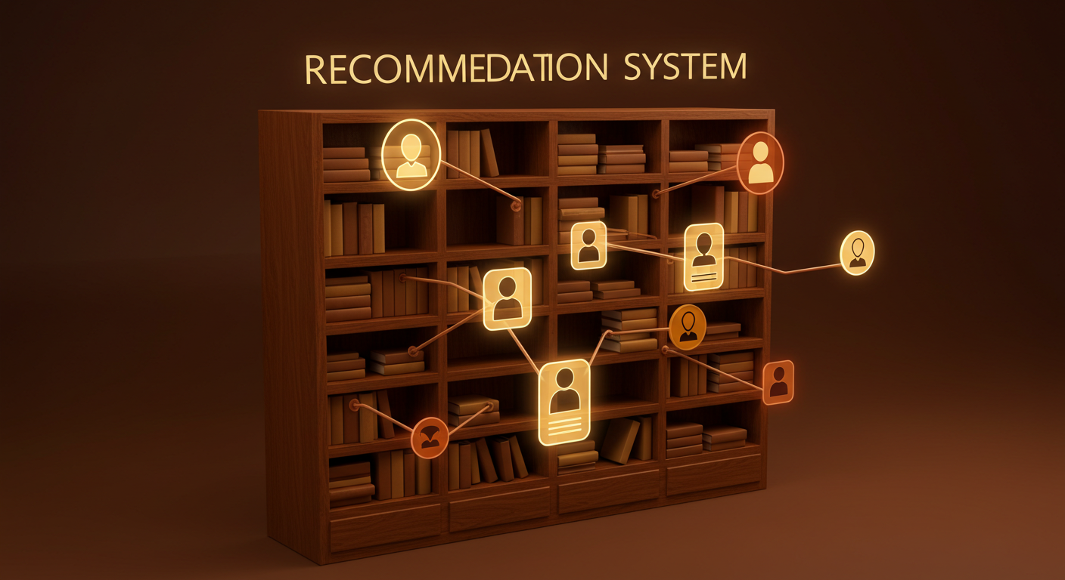
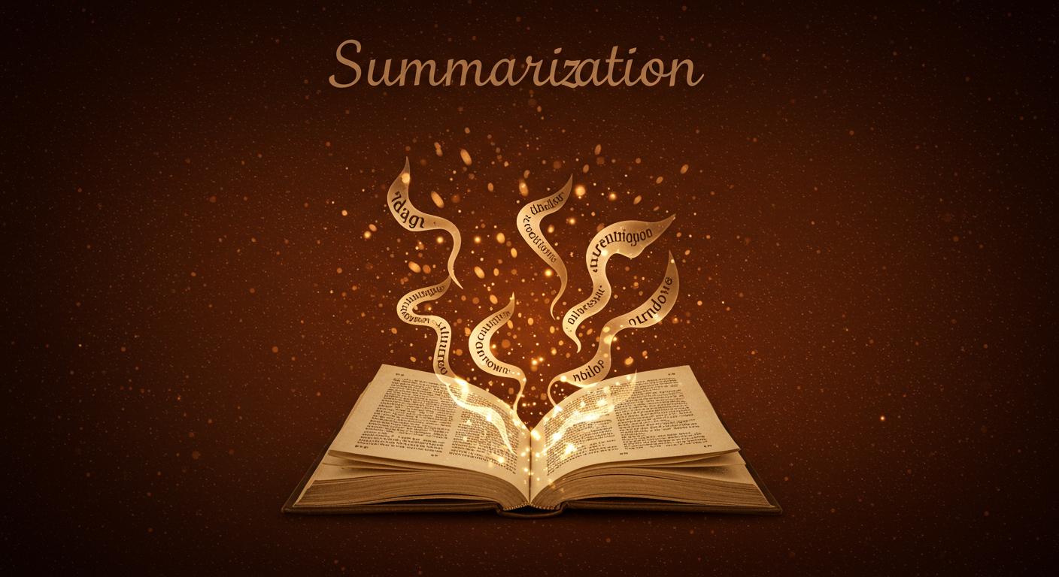
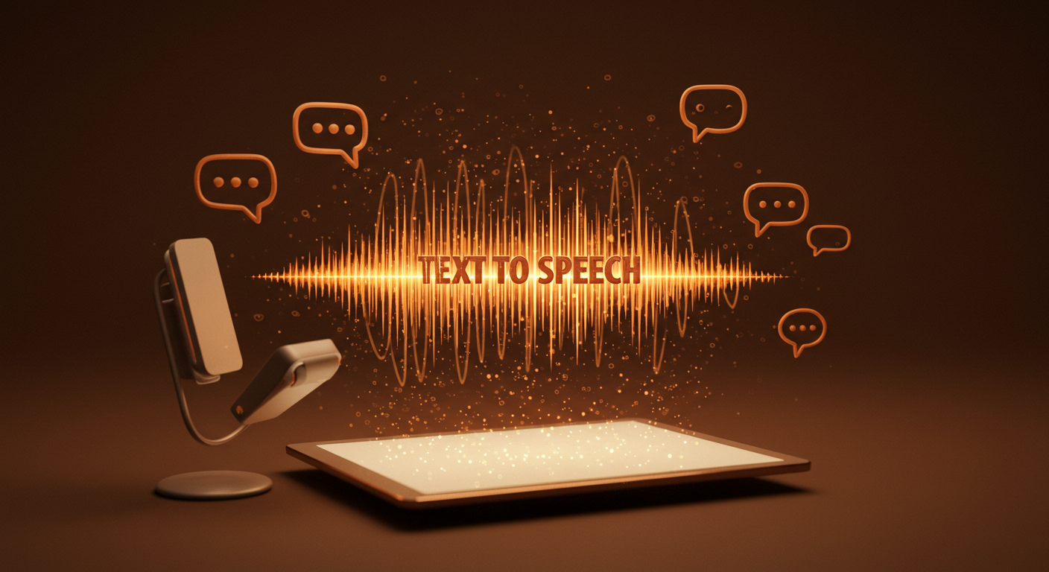
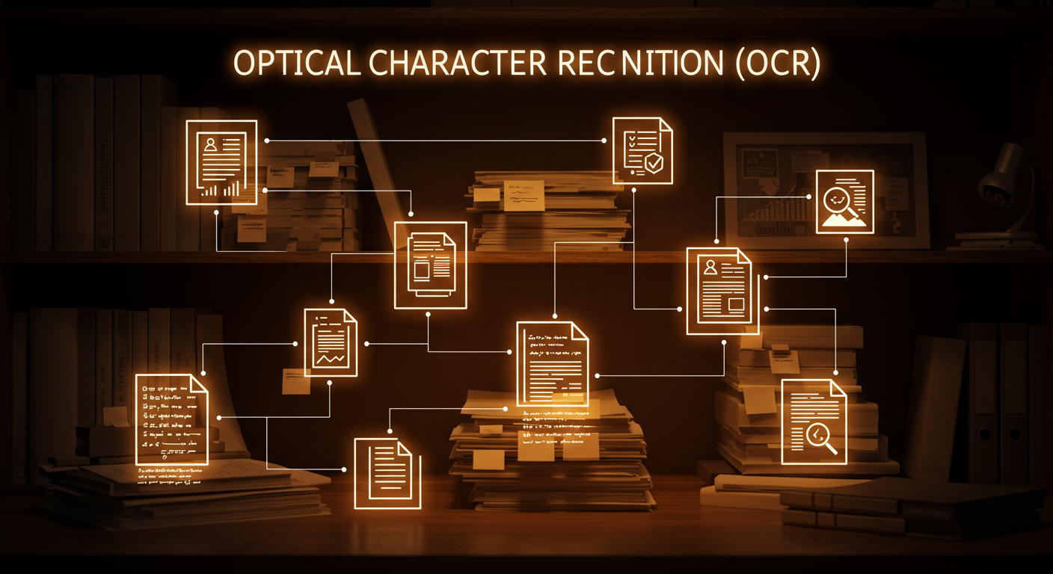
Optical Character Recognition
Recommedation System
Text-To-Speech
Summarization

Slide 35
Recommedation System
Best Book Selection (Weighted Rating)
Recommedation System

Slide 36
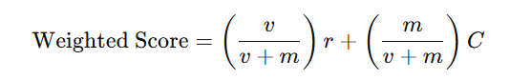
Recommedation System
Best Book Selection (Weighted Rating)
Collaborative Filtering
Recommedation System
Why? Average ratings mislead if vote counts vary
Formula:
r: Book’s avg. rating v: Number of ratings
m: Minimum threshold C: Global avg. rating
The IMDB weighted formula also has a variable m, which it requires to
compute its score .This variable is in place to make sure that only
book’s that are above a certain threshold of popularity are considered
for the rankings

Slide 37
Recommedation System
Collaborative Filtering
Overview: Recommends books based on user ratings and behavior.
Key Components:
User-Item Matrix: Tracks user ratings for books.
Correlation Matrix: Measures book-pair rating relationships.
Steps:
Collect user ratings.
Build user-item matrix.
Calculate book correlations.
Recommend highly correlated books.

Slide 38
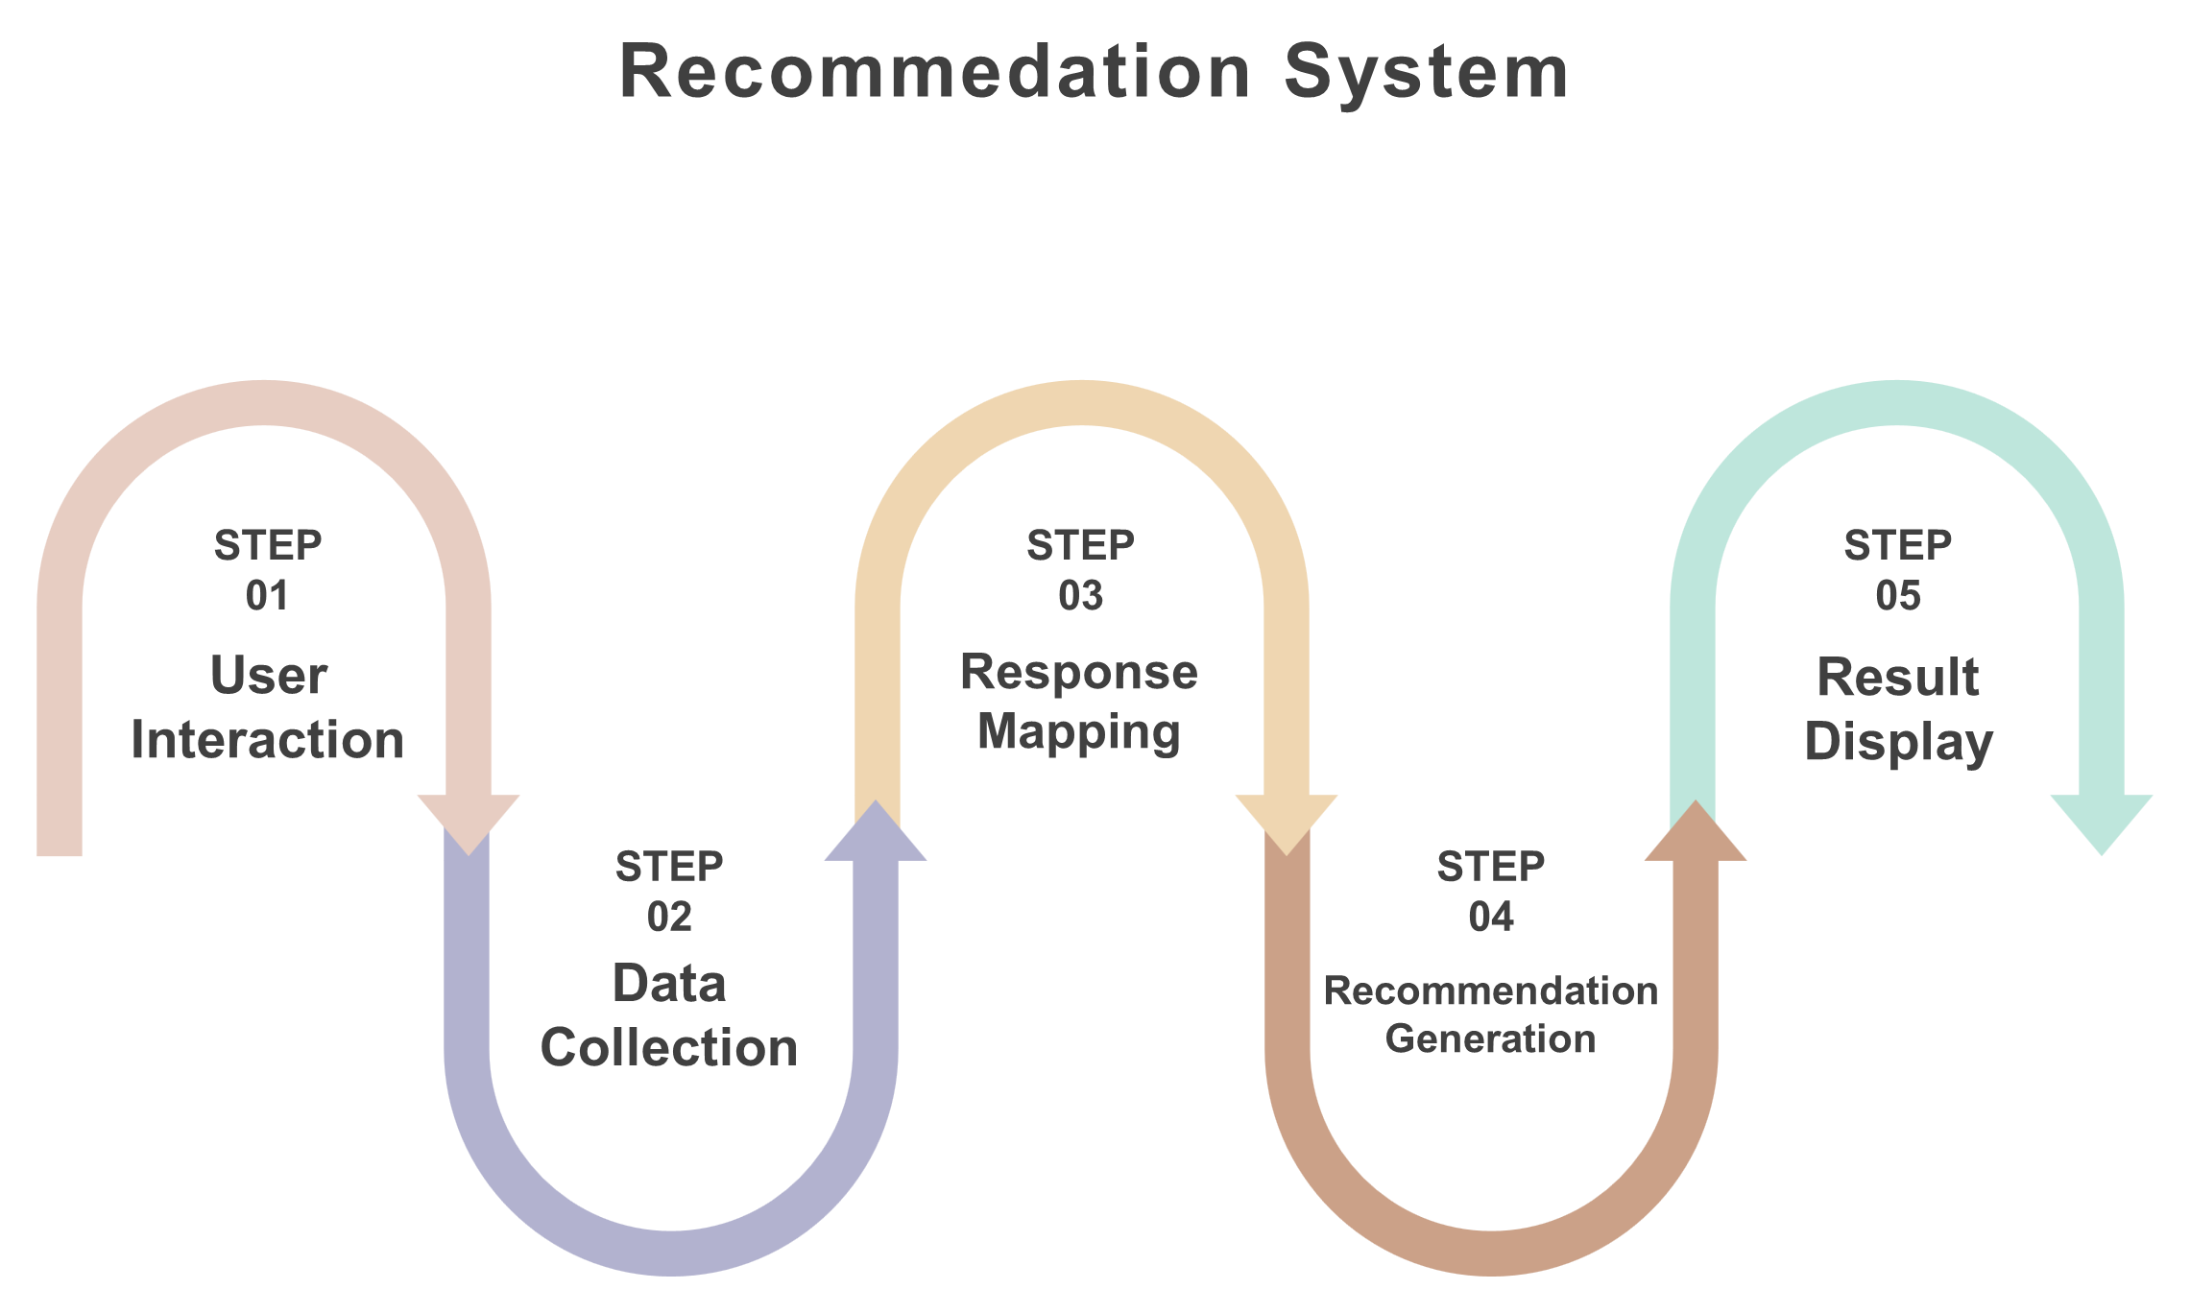
Recommedation System
Content-Based Filtering
Overview: Recommends books by analyzing textual features (descriptions, genres) using
similarity measures. Ideal for new users.
Key Components:
TF-IDF: Converts book text into numerical vectors.
Cosine Similarity: Measures similarity between books.
Similarity Matrix: Stores precomputed book-pair scores.
Steps:
Preprocess book descriptions.
Vectorize text (TF-IDF).
Compute cosine similarity.
Recommend top-N similar books.

Slide 40
Optical Character Recognition
Recommedation System
Text-To-Speech
Summarization

Slide 41
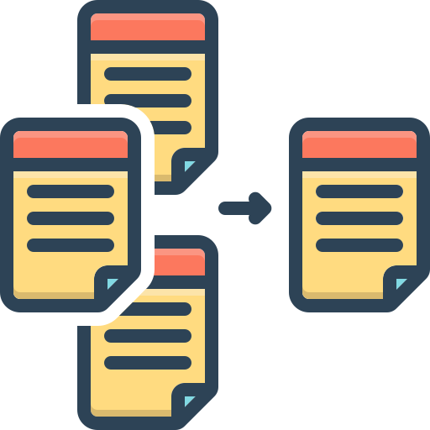
Summarization

Slide 42

Summarization
Summarization
Overview: To provide concise, high-quality summaries of books, helping experienced
readers evaluate content before committing to a full read.
Why It Matters:
Saves time by filtering relevant books quickly.
Helps researchers, students, and professionals extract key insights efficiently.

Slide 43

Summarization
Challenges in Book Summarization
Text Extraction Complexity
Handling different formats (PDF, TXT, etc.).
NLP Challenges
Handling long documents (token limits in models).
Quality vs. Brevity Trade-off
Ensuring summaries are informative yet concise.

Slide 44
Summarization
Challenges in Book Summarization
Text Extraction Complexity
Handling different formats (PDF, TXT, etc.).
NLP Challenges
Handling long documents (token limits in models).
Quality vs. Brevity Trade-off
Ensuring summaries are informative yet concise.

Slide 45
Summarization
Challenges in Book Summarization
Text Extraction Complexity
Handling different formats (PDF, TXT, etc.).
NLP Challenges
Handling long documents (token limits in models).
Quality vs. Brevity Trade-off
Ensuring summaries are informative yet concise.

Slide 46
Summarization
Challenges in Book Summarization
Text Extraction Complexity
Handling different formats (PDF, TXT, etc.).
NLP Challenges
Handling long documents (token limits in models).
Quality vs. Brevity Trade-off
Ensuring summaries are informative yet concise.

Slide 47
Summarization
General Approach
Upload & Text Extraction
Users upload books (PDF, TXT).
Libraries like PyMuPDF extract raw text.
Text Preprocessing
Cleaning (removing whitespace, non-UTF characters).
Chunking long texts (due to model constraints).
Summarization with NLP
Using BART (facebook/bart-large-cnn) for abstractive summarization.
Output Delivery
Displaying a structured, readable summary.

Slide 48
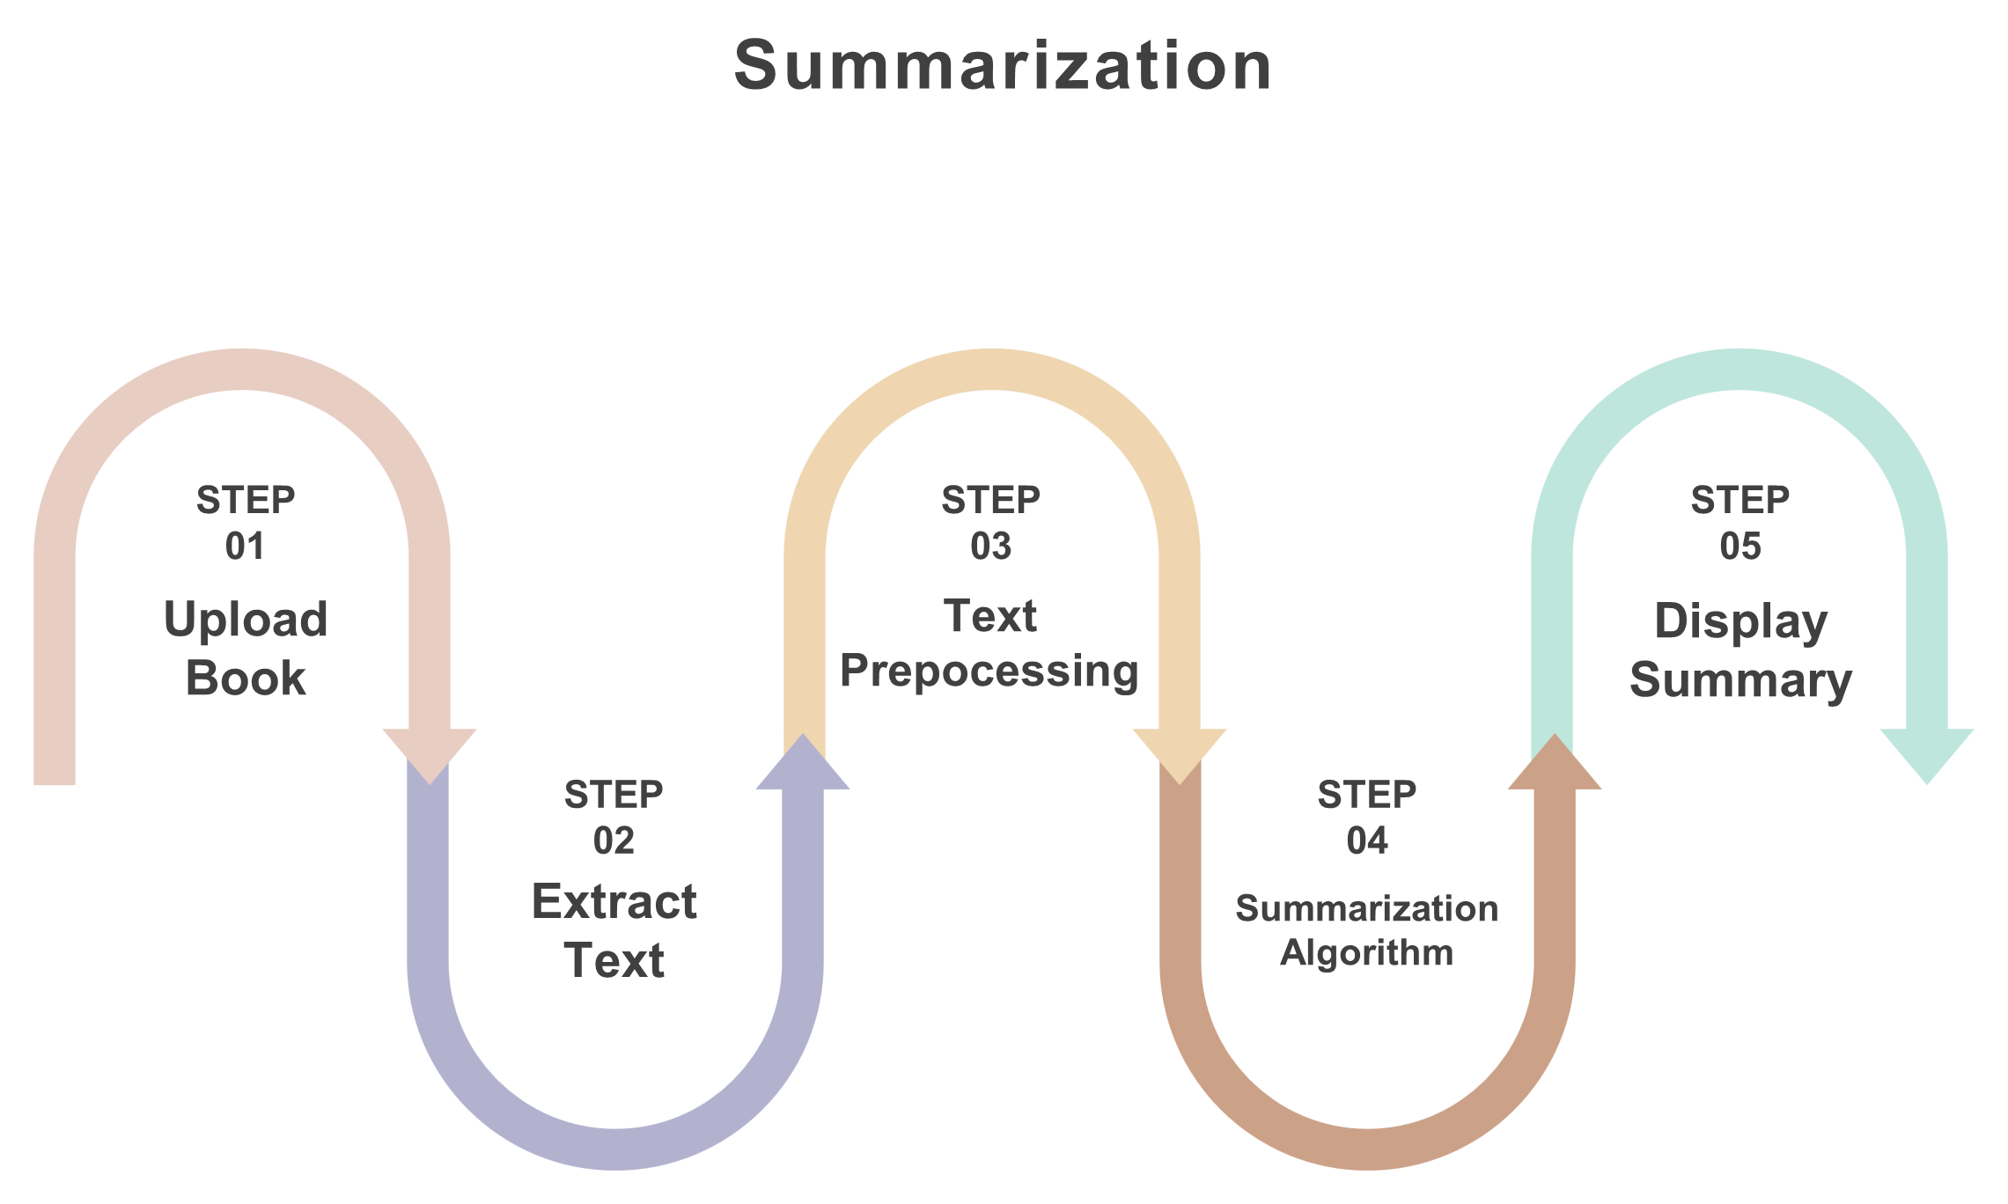

Summarization
Why BART?
Model: facebook/bart-large-cnn
Architecture:
Encoder-Decoder Transformer (12 layers each).

Slide 49



Summarization
Why BART?
Model: facebook/bart-large-cnn
Architecture:
Encoder-Decoder Transformer (12 layers each).
Strengths:
Optimized for summarization.
Balances conciseness and coherence.
Works offline (unlike GPT-3.5).

Slide 50

Summarization
Why BART?
Model: facebook/bart-large-cnn
Architecture:
Encoder-Decoder Transformer (12 layers each).
Strengths:
Optimized for summarization.
Limitations:
Max input: 1024 tokens (requires chunking).
Struggles with scanned/image-based PDFs.

Slide 51
Summarization
Why BART?
Model: facebook/bart-large-cnn
Architecture:
Encoder-Decoder Transformer (12 layers each).
Strengths:
Optimized for summarization.
Limitations:
Max input: 1024 tokens (requires chunking).
Struggles with scanned/image-based PDFs.

Slide 52
Summarization
Why BART?
Key Parameters & Performance
Model: facebook/bart-large-cnn
Architecture:
Encoder-Decoder Transformer (12 layers each).
Strengths:
Optimized for summarization.
Balances conciseness and coherence.
Works offline (unlike GPT-3.5).
Limitations:
Max input: 1024 tokens (requires chunking).
Struggles with scanned/image-based PDFs.

Slide 53

Summarization
Key Parameters & Performance
max_length :
Controls summary length
min_length :
Avoids overly short summaries
num_beams Higher :
better quality (but slower)
Truncation
Required for long documents

Slide 54
Summarization
Key Parameters & Performance
max_length :
Controls summary length
min_length :
Avoids overly short summaries
num_beams Higher :
better quality (but slower)
Truncation
Required for long documents

Slide 55
Summarization
Key Parameters & Performance
max_length :
Controls summary length
min_length :
Avoids overly short summaries
num_beams Higher :
better quality (but slower)
Truncation
Required for long documents

Slide 56
Summarization
Key Parameters & Performance
max_length :
Controls summary length
min_length :
Avoids overly short summaries
num_beams Higher :
better quality (but slower)
Truncation
Required for long documents

Slide 57
Summarization
Key Parameters & Performance
max_length :
Controls summary length
min_length :
Avoids overly short summaries
num_beams Higher :
better quality (but slower)
Truncation
Required for long documents

Slide 58
Summarization
Key Parameters & Performance
Strengths & Limitations
Strengths:
Fast, high-quality summaries.
Works offline (privacy-friendly).
Customizable parameters.
max_length :
Controls summary length
min_length :
Avoids overly short summaries
num_beams Higher :
better quality (but slower)
Truncation
Required for long documents

Slide 59
Optical Character Recognition
Recommedation System
Text-To-Speech
Summarization

Slide 60

Text-To-Speech
Text-To-Speech

Slide 61
Text-To-Speech
Text-To-Speech
Overview:
Convert uploaded books into high-quality speech, offering an accessible alternative for:
Visually impaired users.
Busy individuals who prefer audiobooks.
Language learners improving pronunciation.
Why It Matters:
Inclusivity: Supports accessibility needs.
Convenience: Listen to books while multitasking.

Slide 62
Text-To-Speech
Challenges in TTS for Books
Text Extraction & Preprocessing
Handling PDFs, TXT, etc., with formatting noise.
Long documents require chunking for TTS models.
Voice Quality & Naturalness
Avoiding robotic, monotonous speech.
Preserving emotion and intonation.
Multilingual & Voice Cloning
Supporting multiple languages seamlessly.
Zero-shot cloning (mimicking a voice from a short sample).

Slide 63
Text-To-Speech
Challenges in TTS for Books
Text Extraction & Preprocessing
Handling PDFs, TXT, etc., with formatting noise.
Long documents require chunking for TTS models.
Voice Quality & Naturalness
Avoiding robotic, monotonous speech.
Preserving emotion and intonation.
Multilingual & Voice Cloning
Supporting multiple languages seamlessly.
Zero-shot cloning (mimicking a voice from a short sample).

Slide 64
Text-To-Speech
Challenges in TTS for Books
Text Extraction & Preprocessing
Handling PDFs, TXT, etc., with formatting noise.
Long documents require chunking for TTS models.
Voice Quality & Naturalness
Avoiding robotic, monotonous speech.
Preserving emotion and intonation.
Multilingual & Voice Cloning
Supporting multiple languages seamlessly.
Zero-shot cloning (mimicking a voice from a short sample).

Slide 65
Text-To-Speech
Challenges in TTS for Books
Text Extraction & Preprocessing
Handling PDFs, TXT, etc., with formatting noise.
Long documents require chunking for TTS models.
Voice Quality & Naturalness
Avoiding robotic, monotonous speech.
Preserving emotion and intonation.
Multilingual & Voice Cloning
Supporting multiple languages seamlessly.
Zero-shot cloning (mimicking a voice from a short sample).

Slide 66
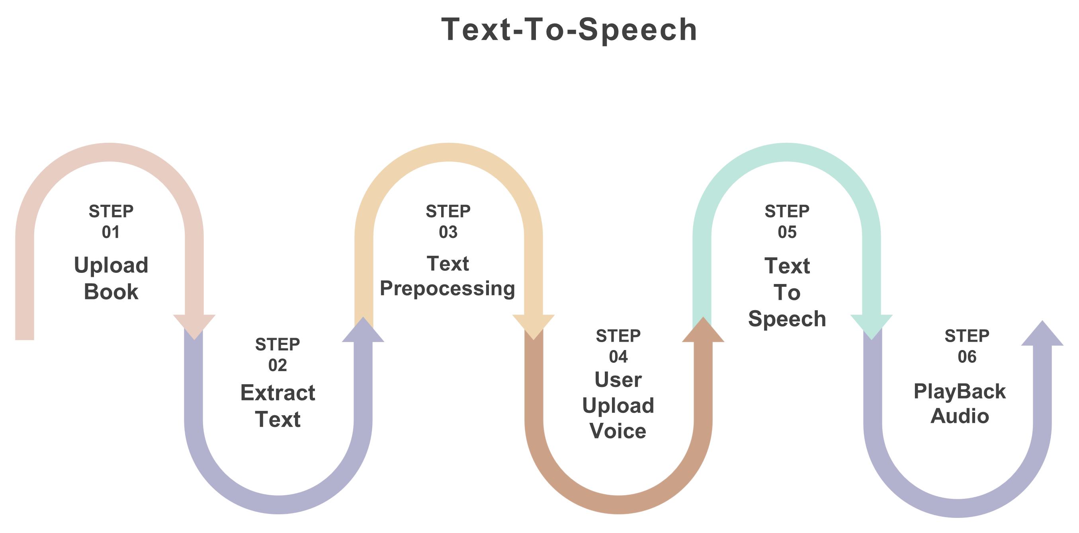
Text-To-Speech
General Approach
Upload & Text Extraction
Users upload books (PDF, TXT).
Extracts the text from the File.
Voice Cloning
Users upload a short voice sample (3–5 sec).
TTS Conversion
YourTTS (multilingual, zero-shot cloning) generates speech.
Customizable speed, and voice.
Audio Delivery
Play in-browser or download (MP3/WAV).

Slide 67
Text-To-Speech
Why YourTTS?
Model: YourTTS (Zero-shot, Multilingual)

Slide 68
Text-To-Speech
Why YourTTS?
Model: YourTTS (Zero-shot, Multilingual)
Key Features:
Clone voices from just 3–5 sec samples.
Supports cross-lingual speech .
Open-source (built by coqui) and offline-capable

Slide 69
Text-To-Speech
Why YourTTS?
Key Parameters & Performance
Model: YourTTS (Zero-shot, Multilingual)
The model has Three key components:
Speaker Encoder
Takes in the voice sample
Extracts a speaker embedding – a numeric representation of
the speaker’s vocal characteristics This embedding tells the model
Text-to-Spectrogram Synthesizer
Uses a model similar to Tacotron2 or FastSpeech
Converts input text into a mel-spectrogram
Vocoder (HiFi-GAN)
Converts the spectrogram into actual audio waveform
Generates realistic speech using a deep generative network
speaker_wav
Changes voice (clone from sample)
language
Controls accent/pronunciation (e.g., "en")
speed
Faster/slower speech
pitch
Higher/deeper tone

Slide 70
Text-To-Speech
Key Parameters & Performance
speaker_wav
Changes voice (clone from sample)
language
Controls accent/pronunciation (e.g., "en")
speed
Faster/slower speech

Slide 71
Text-To-Speech
Key Parameters & Performance
speaker_wav
Changes voice (clone from sample)
language
Controls accent/pronunciation (e.g., "en")
speed
Faster/slower speech

Slide 72
Text-To-Speech
Key Parameters & Performance
speaker_wav
Changes voice (clone from sample)
language
Controls accent/pronunciation (e.g., "en")
speed
Faster/slower speech

Slide 73
Text-To-Speech
Key Parameters & Performance
speaker_wav
Changes voice (clone from sample)
language
Controls accent/pronunciation (e.g., "en")
speed
Faster/slower speech

Slide 74
Text-To-Speech
Key Parameters & Performance
speaker_wav
Changes voice (clone from sample)
language
Controls accent/pronunciation (e.g., "en")
speed
Faster/slower speech

Slide 75
Optical Character Recognition
Recommedation System
Text-To-Speech
Summarization

Slide 76
Optical Character Recognition
Optical Character Recognition

Slide 77
Optical Character Recognition
Optical Character Recognition
Objective:
Extract editable text from images (scanned books, photos) to enable:
Digitization of printed content.
Downstream processing (summarization, translation).
Why It Matters:
Preserves and makes legacy books searchable.
Enhances accessibility for visually impaired users.

Slide 78
Optical Character Recognition
Challenges in OCR for Books
Image Quality Issues
Blurry text, shadows, or skewed pages reduce accuracy.
Format Diversity
Handling PNG, JPG, GIF, and future PDF scans.
Language Support
Extending beyond English .
Layout Preservation
Maintaining paragraphs, tables, and formatting.

Slide 79
Optical Character Recognition
Challenges in OCR for Books
Image Quality Issues
Blurry text, shadows, or skewed pages reduce accuracy.
Format Diversity
Handling PNG, JPG, GIF, and future PDF scans.
Language Support
Extending beyond English .
Layout Preservation
Maintaining paragraphs, tables, and formatting.

Slide 80
Optical Character Recognition
Challenges in OCR for Books
Image Quality Issues
Blurry text, shadows, or skewed pages reduce accuracy.
Format Diversity
Handling PNG, JPG, GIF, and future PDF scans.
Language Support
Extending beyond English .
Layout Preservation
Maintaining paragraphs, tables, and formatting.

Slide 81
Optical Character Recognition
Challenges in OCR for Books
Image Quality Issues
Blurry text, shadows, or skewed pages reduce accuracy.
Format Diversity
Handling PNG, JPG, GIF, and future PDF scans.
Language Support
Extending beyond English .
Layout Preservation
Maintaining paragraphs, tables, and formatting.

Slide 82
Optical Character Recognition
Challenges in OCR for Books
Image Quality Issues
Blurry text, shadows, or skewed pages reduce accuracy.
Format Diversity
Handling PNG, JPG, GIF, and future PDF scans.
Language Support
Extending beyond English .
Layout Preservation
Maintaining paragraphs, tables, and formatting.

Slide 83
Optical Character Recognition
Challenges in OCR for Books
Image Quality Issues
Blurry text, shadows, or skewed pages reduce accuracy.
Format Diversity
Handling PNG, JPG, GIF, and future PDF scans.
Language Support
Extending beyond English .
Layout Preservation
Maintaining paragraphs, tables, and formatting.

Slide 84
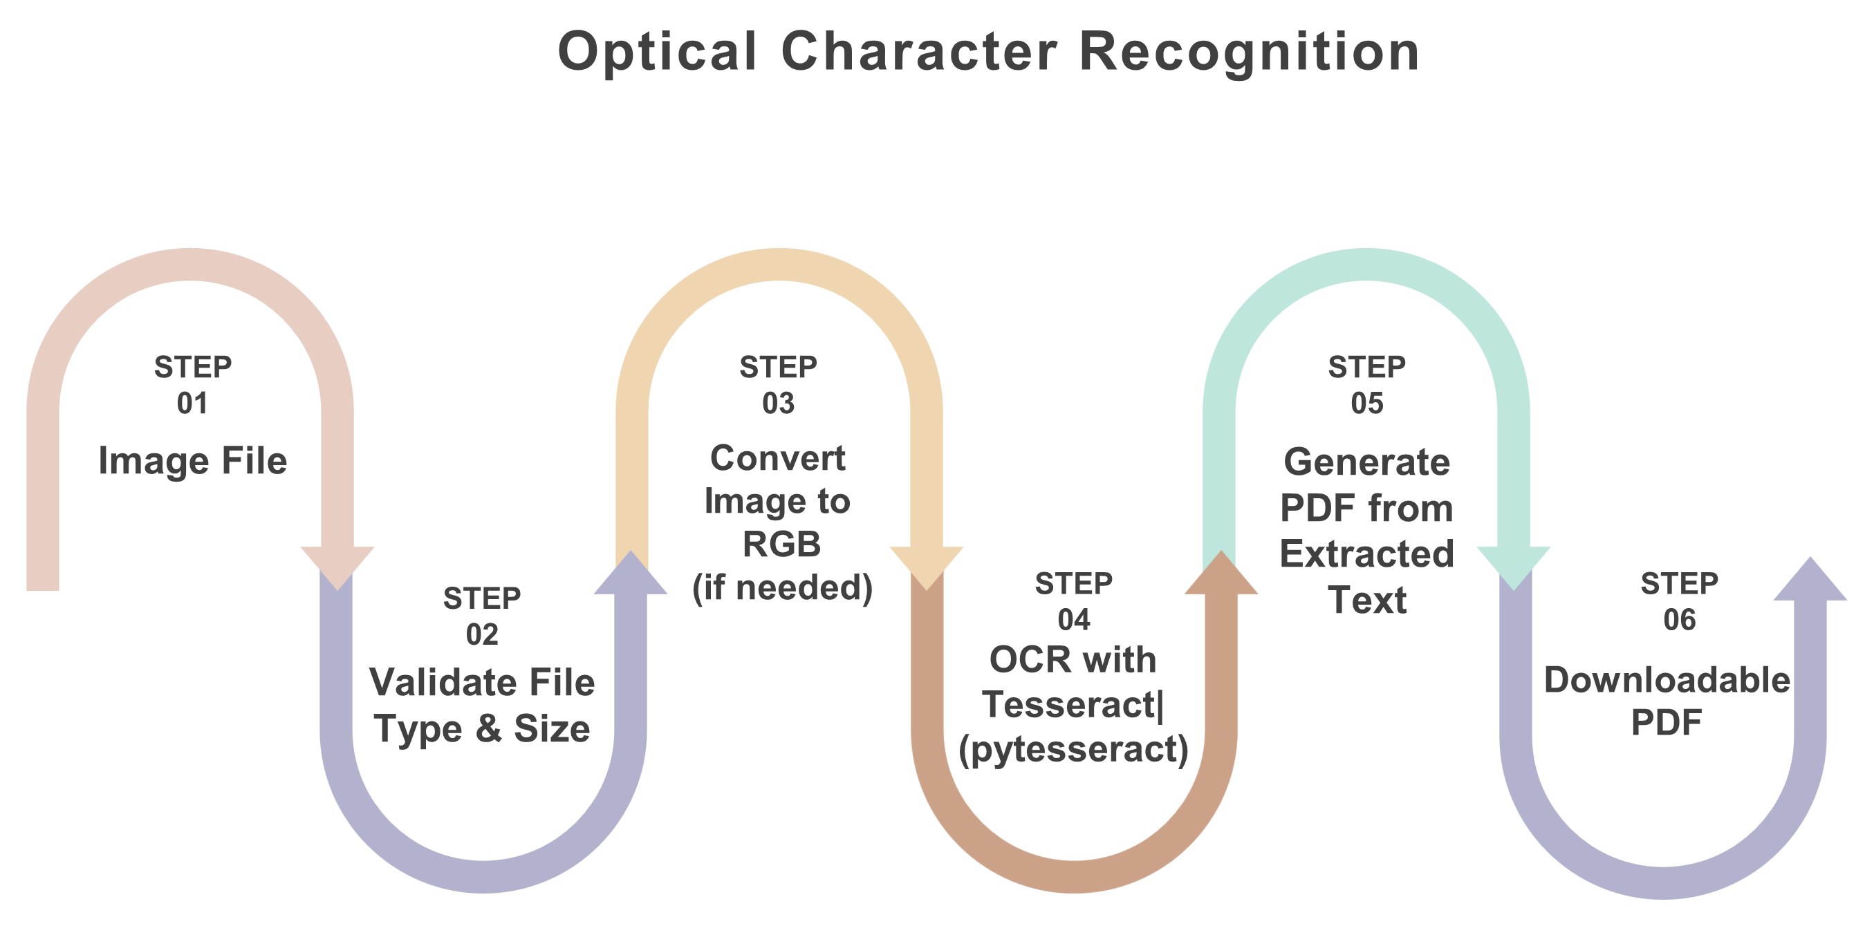
Optical Character Recognition
General Approach
Upload Image
Users submit PNG/JPG/GIF files
Preprocessing (Future)
Deskewing, denoising, contrast adjustment.
Text Extraction
Tesseract OCR via pytesseract
Output Generation
Editable text or PDF (using ReportLab).

Slide 85
Optical Character Recognition
Why Tesseract?
Tesseract OCR (via pytesseract)

Slide 86



Optical Character Recognition
Tesseract
"From Pixels to Words: Understanding Tesseract’s OCR Pipeline"
Image Preprocessing:
● Image Acquisition
● preprocessing
Rescaling : Ensuring the image is within a suitable resolution for OCR.
Noise Reduction
Binarization : Converting the image to a binary (black and white) format to improve contrast and readability of text

Slide 87


Optical Character Recognition
Tesseract
"From Pixels to Words: Understanding Tesseract’s OCR Pipeline"
2. Text Localization:
● Tesseract employs techniques to locate and isolate regions of the image that likely contain text (text localization). This step is crucial for reducing computational effort and focusing OCR processing only on relevant areas.
3. Page Segmentation:
● Tesseract applies page segmentation algorithms to determine the layout and structure of text on the image. This step categorizes the image into segments

Slide 88

Optical Character Recognition
Tesseract
"From Pixels to Words: Understanding Tesseract’s OCR Pipeline"
4. Optical Character Recognition:
● Tesseract utilizes OCR algorithms, which can vary depending on the version and configuration (`--oem` option), to recognize and convert patterns of pixels into meaningful characters.
● Tesseract extracts features from text segments and matches these features against its trained models to identify characters and words.
● Tesseract integrates language-specific models (trained data files) to interpret text in multiple languages

Slide 89


Optical Character Recognition
Tesseract
"From Pixels to Words: Understanding Tesseract’s OCR Pipeline"
5. Post-Processing:
Tesseract may apply additional algorithms to refine and improve recognition results:
● Spell Checking : Correcting recognized text based on dictionary checks.
● Format Reconstruction: Reconstructing the recognized text into structured formats like paragraphs or tables.
6. Output:
- Finally, Tesseract outputs the recognized text in a digital format that can be further processed or utilized by other applications.

Slide 90
Optical Character Recognition
Why Tesseract?
1. Open-Source & Free
Unlike commercial OCR engines (like ABBYY FineReader or Adobe Acrobat), Tesseract is completely free and open-source .
No licensing restrictions, making it ideal for research and commercial applications.
2. High Accuracy
Works well for printed text and moderately well for handwritten text (with fine-tuning).
3. Multi-Language Support
Supports 100+ languages, including right-to-left (RTL) languages like Arabic and Hebrew.
Can be trained for custom languages/fonts if needed.

Slide 91
Optical Character Recognition
Why Tesseract?
4. Integration & Customizability
Works seamlessly with Python (via PyTesseract), C++, Java, and other languages.
5. Cross-Platform Compatibility
Runs on Windows, Linux, macOS, and even embedded systems.
6. Strong Community & Active Development
Backed by Google .
Regular updates and improvements.

Slide 92
Optical Character Recognition
When NOT to Use Tesseract?
Low-quality/scanned documents .
Complex layouts (tables, multi-column text)
Real-time OCR on mobile devices

Slide 93
Optical Character Recognition
Why Tesseract?
Key Parameters & Performance
Tesseract OCR (via pytesseract)
Strengths:
Open-source, offline, and highly customizable.
Supports 100+ languages (with training).
UPLOAD_FOLDER
Temp storage path
ALLOWED_EXTENSIONS
Permitted formats (PNG/JPG/GIF)
Limitations:
Accuracy drops with poor image quality.
No built-in image enhancement.

Slide 94
Optical Character Recognition
Key Parameters & Performance
UPLOAD_FOLDER
Temp storage path
ALLOWED_EXTENSIONS
Permitted formats (PNG/JPG/GIF)

Slide 95
Optical Character Recognition
Key Parameters & Performance
UPLOAD_FOLDER
Temp storage path
ALLOWED_EXTENSIONS
Permitted formats (PNG/JPG/GIF)

Slide 96

Front-End

Slide 97
Front-End
HTML: Structures the content of your website (headings, buttons, forms for book upload, etc.).
Provides the basic layout for sections like recommendation, summarization, text-to-speech features and Optical Character Recognition
CSS:Enhances the visual appeal of your website with styling (fonts, colors, layout design).Makes the interface user-friendly and responsive for different devices (e.g., mobile, tablet, desktop).
JavaScript:Adds interactivity, such as enabling users to upload books, navigate between sections, and dynamically display recommendations.
Manages client-side validation (e.g., ensuring proper file formats for book uploads).
Makes API calls to the backend to fetch recommendations, summaries, optical character recognition ,text-to-speech results, and updates the UI in real time.

Slide 98
Back-End

Slide 99
Back-End
The API acts as a bridge between your backend and the AI models for processing tasks like recommendations, summarization, text-to-speech conversion and optical character recognition.
About Flask Framework
Flask is a lightweight and flexible web framework for Python, It provides essential tools to build web applications with minimal setup, using simple routing and a built-in development server. Flask is highly extensible, allowing developers to add functionalities through various extensions, such as Flask-WTF for form handling.
Flask framework Advantages:
● Simplicity and Ease of Use ● Lightweight Framework
● Extensive Documentation and Community Support ● Integration with Python Ecosystem
● Scalability ● Flexibility

Slide 100
Conclusion
&
Future Work

Slide 101



Conclusion and Future Work
Any Question?
Conclusion
This project presents an innovative reading platform that combines
Recommendation Systems, Book Summarization, OCR, and Text-to-Speech
(TTS) to create a smarter, more inclusive reading experience . By integrating
NLP, machine learning, and accessibility tools, it empowers users to discover,
understand, and enjoy books more effectively — whether they are new
readers, advanced readers, or users with special needs.
Future Work
Arabic Language Support
Mobile Application Development
Advanced Search Engine Integration

Slide 102
Any Question?
Thank You

Slide 103
Thank You

